Slide 1

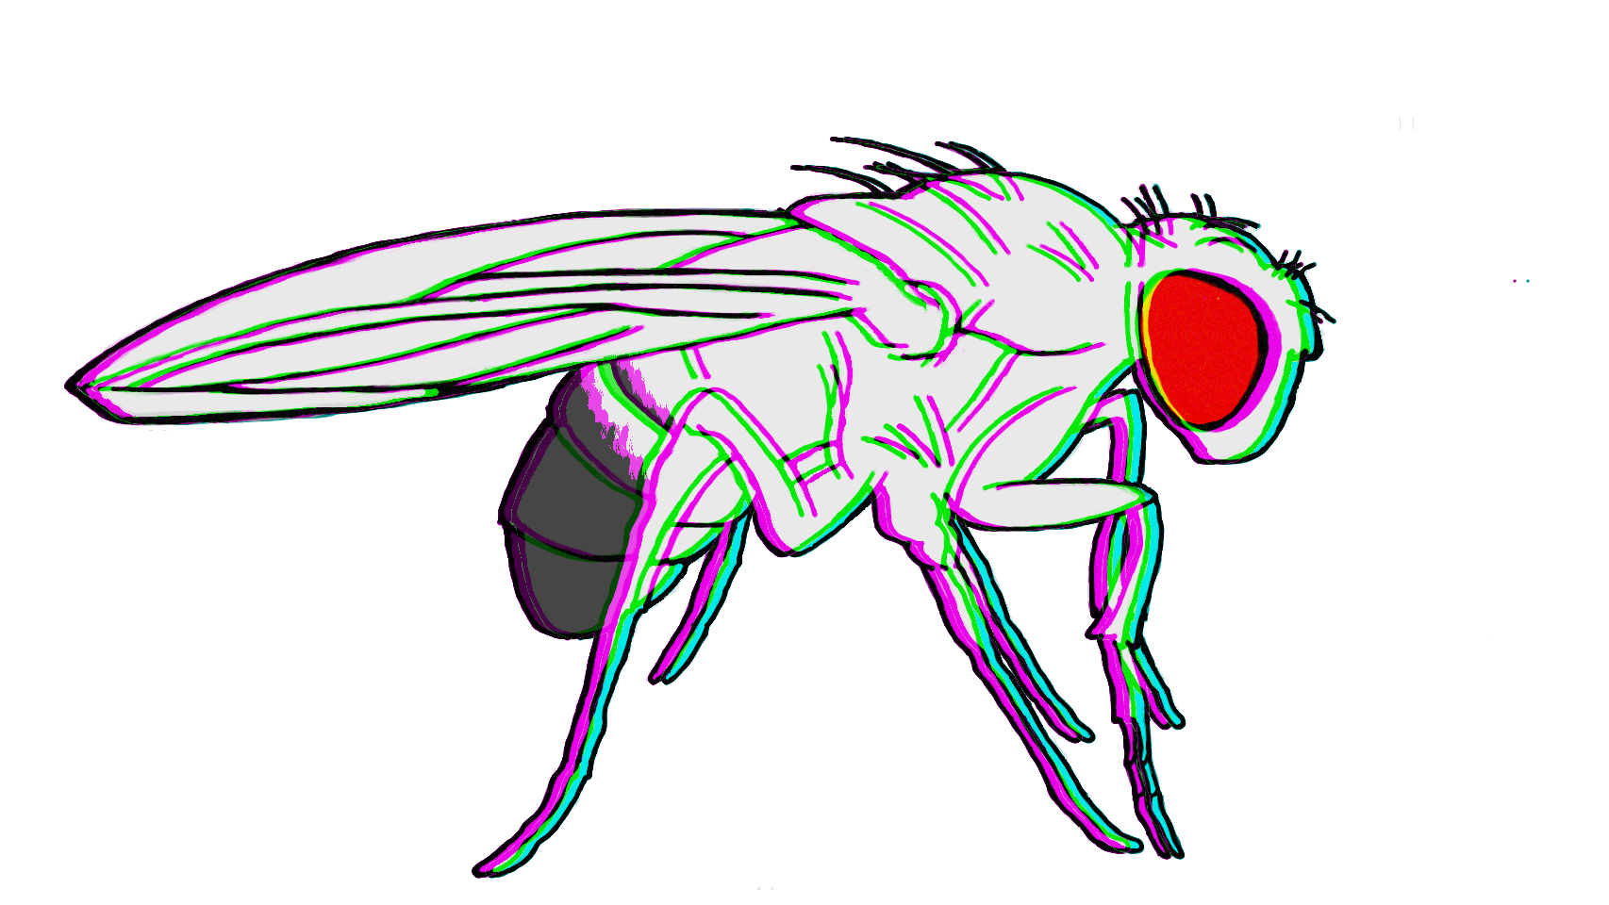

Slide 2
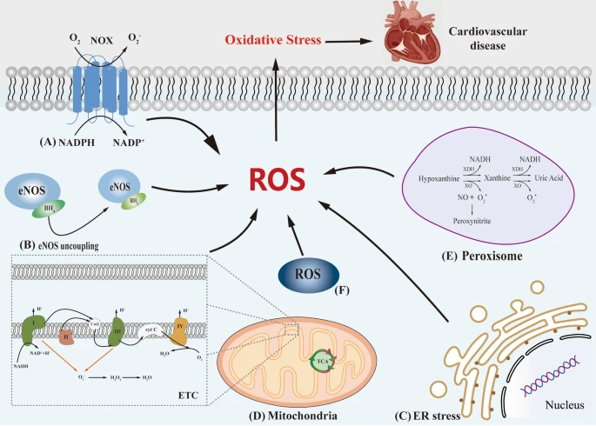
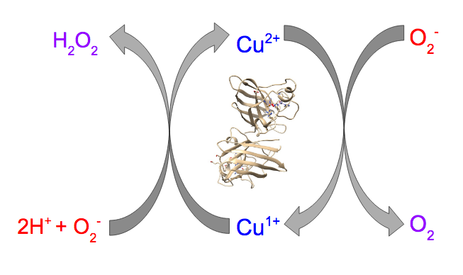
SOD1 breaks down toxic superoxide molecules

Slide 3
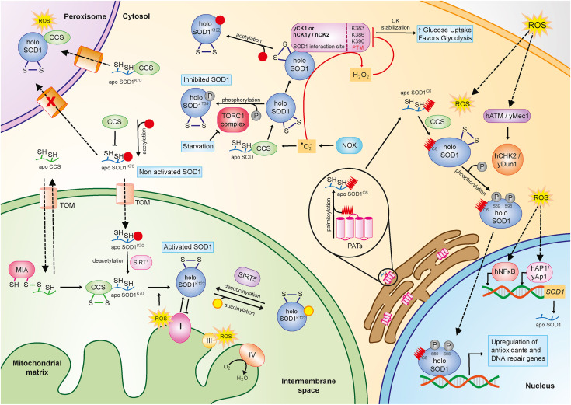
SOD1has all kinds of functions throughout the cell
Differential localization
ER stress and proteostasis
Mitochondrial dysfunction and metabolism
Axonal and synapse integrity

Slide 4
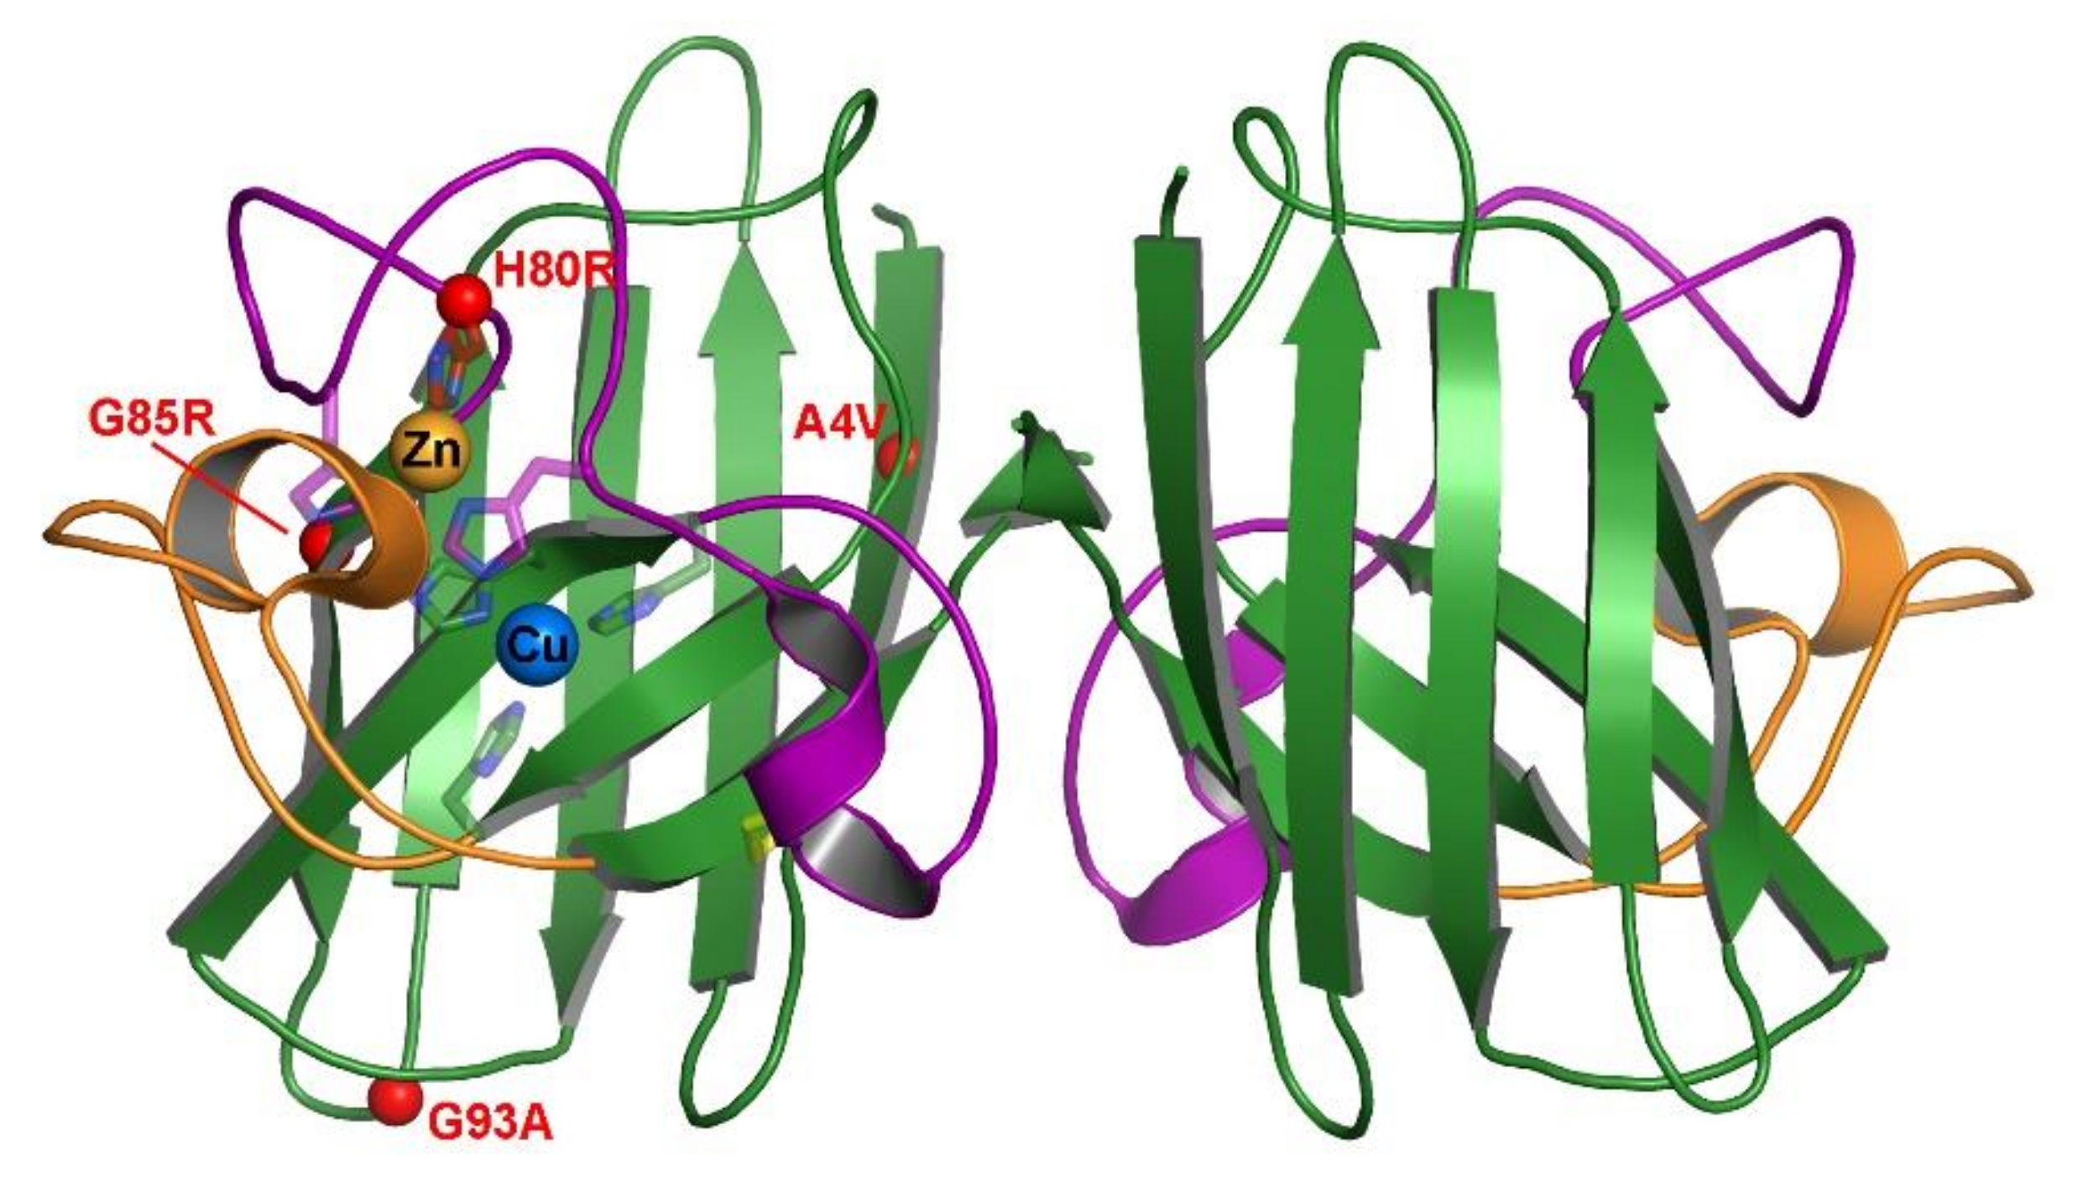
SOD1has all kinds of functions throughout the cell
G85R is located near the “zinc-loop”
Has decreased affinity for copper and zinc compared to WT (https://doi.org/10.1074/jbc.M112087200 10.1074/jbc.M801522200)

Slide 5
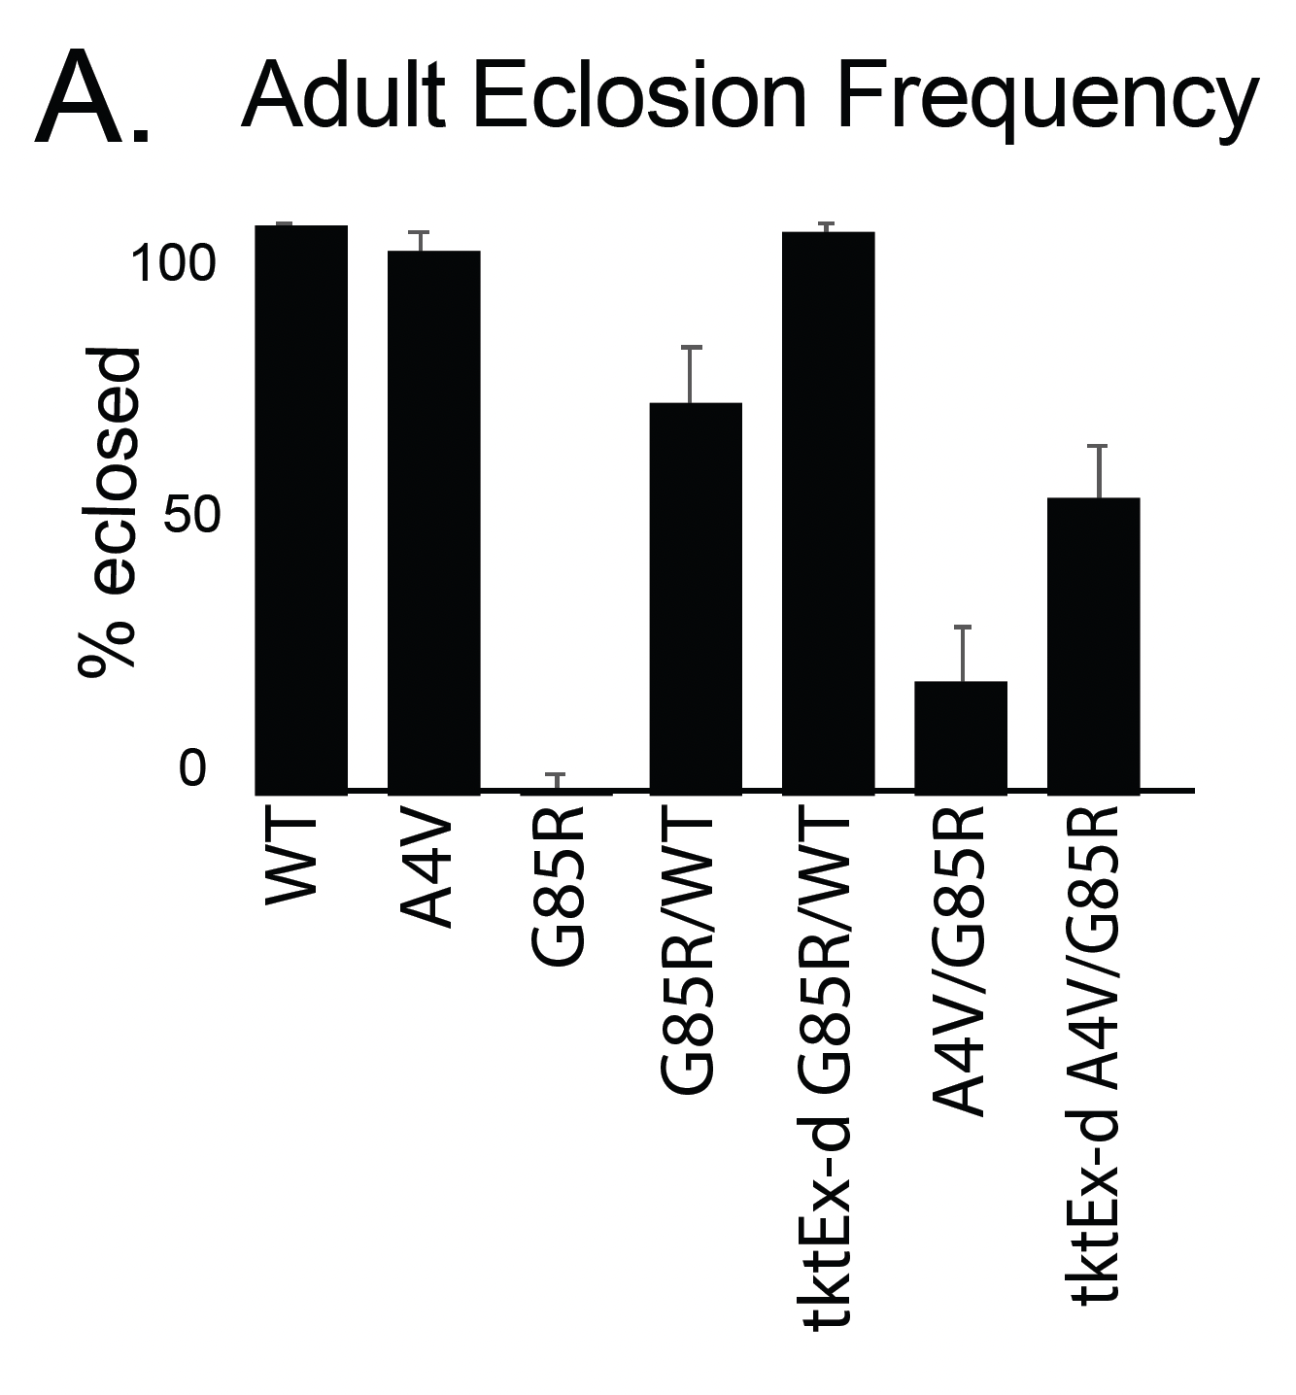
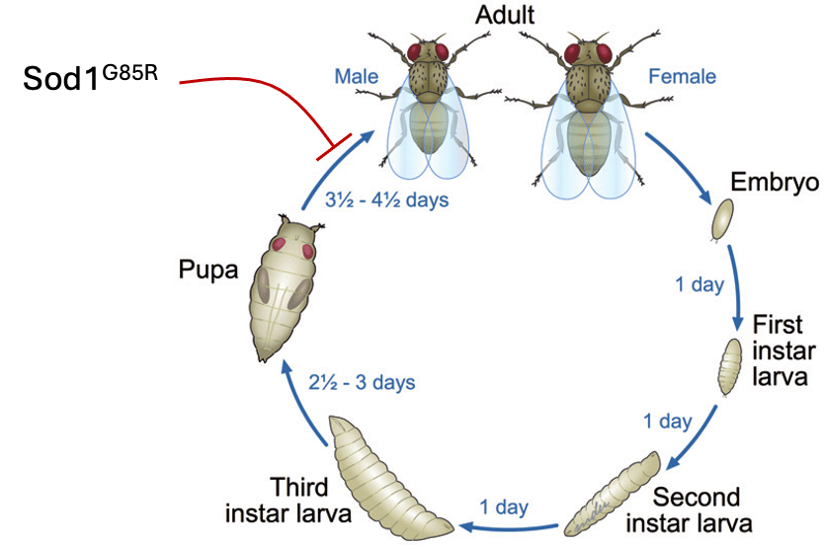
SOD1^{G85R} does not eclose
Transketolase (TKT) rescues G85R eclosion
TKT

Slide 6
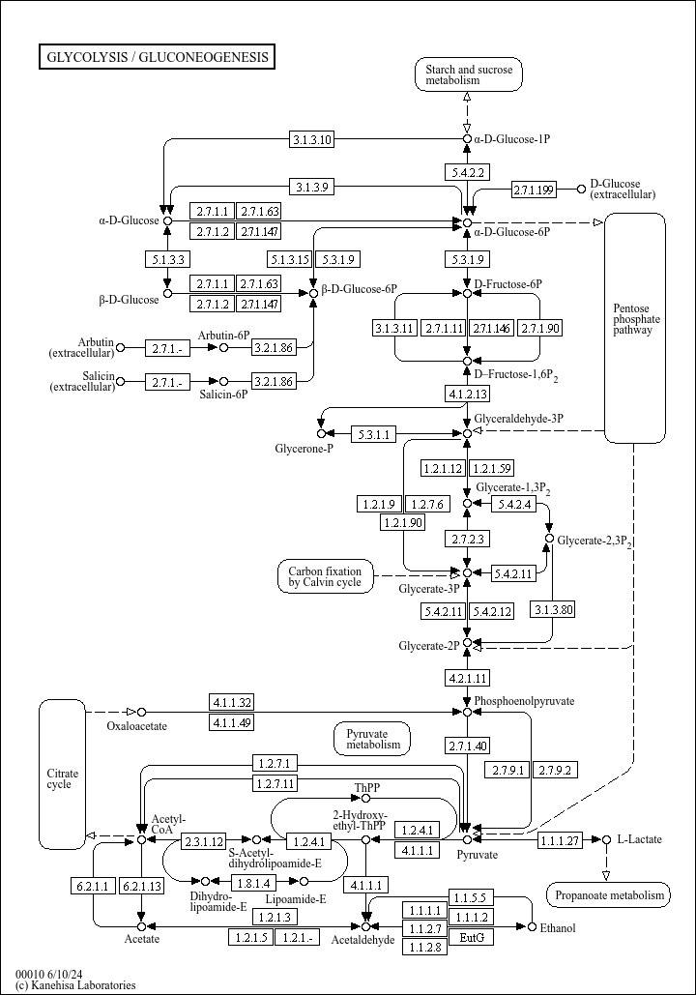
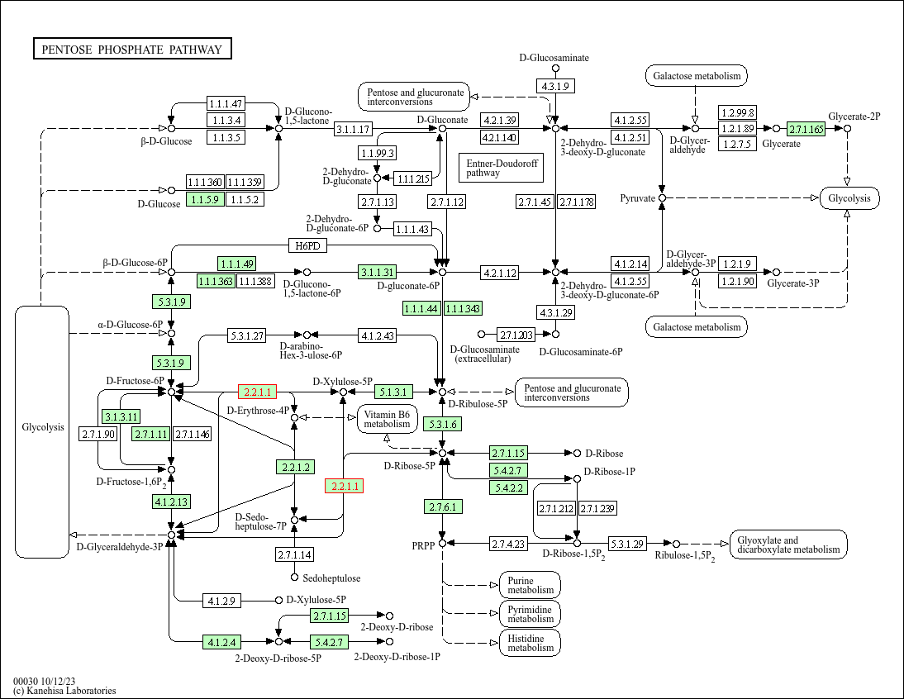
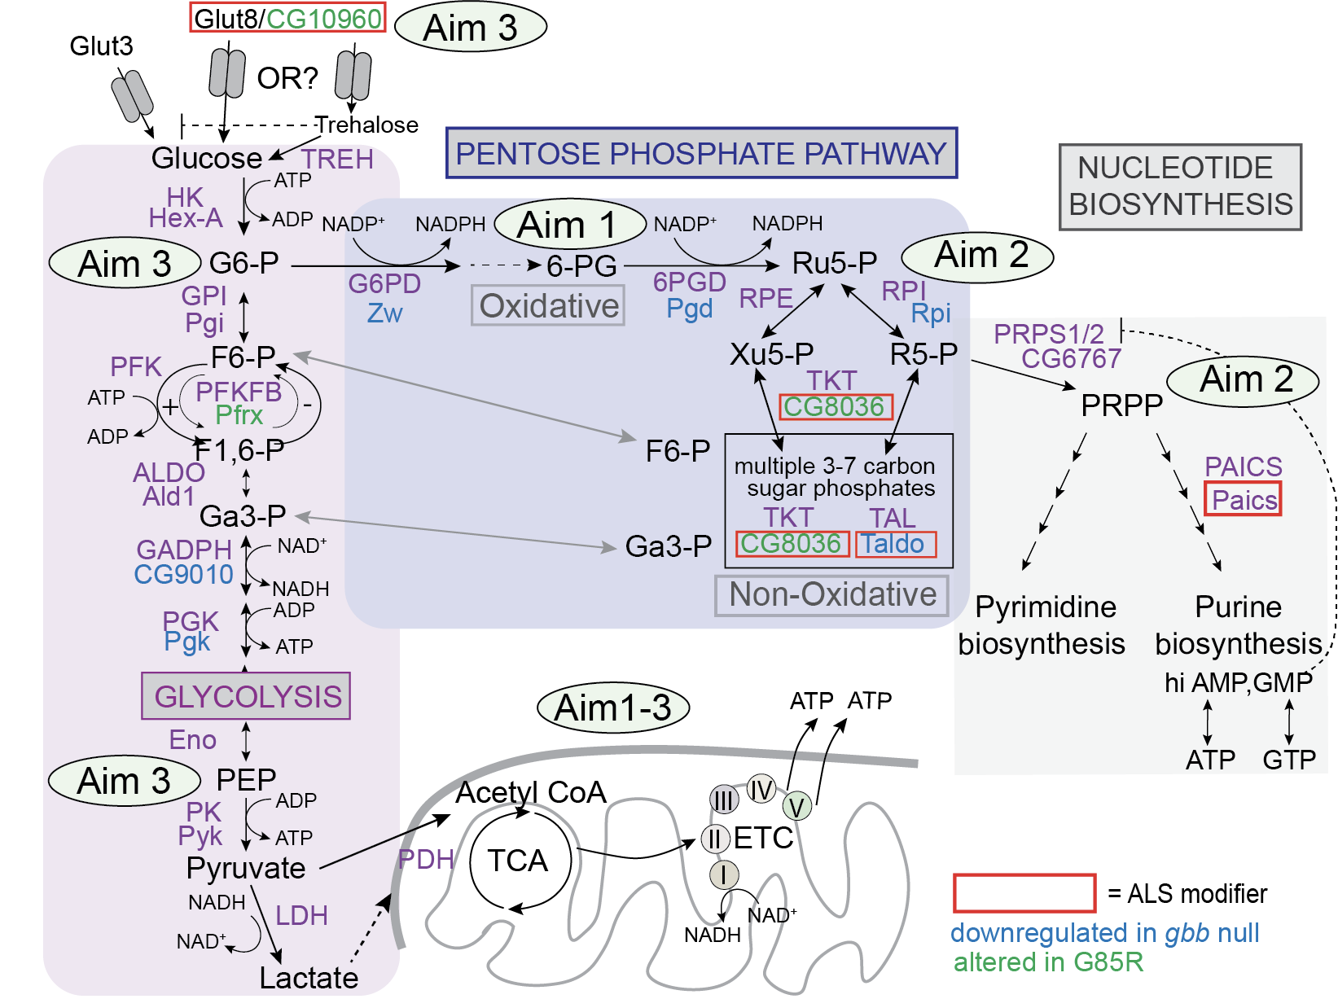
TKT connects Glycolysis to the PPP
TKT over-expression OR deficiency rescues eclosion in G85R

Slide 7
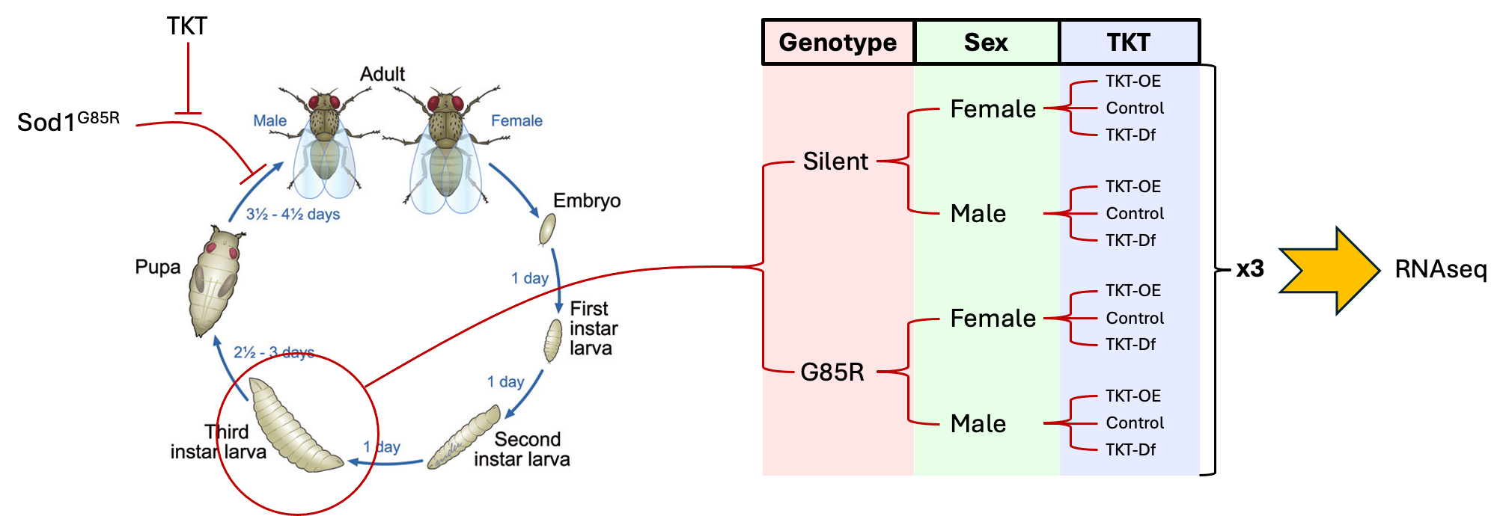
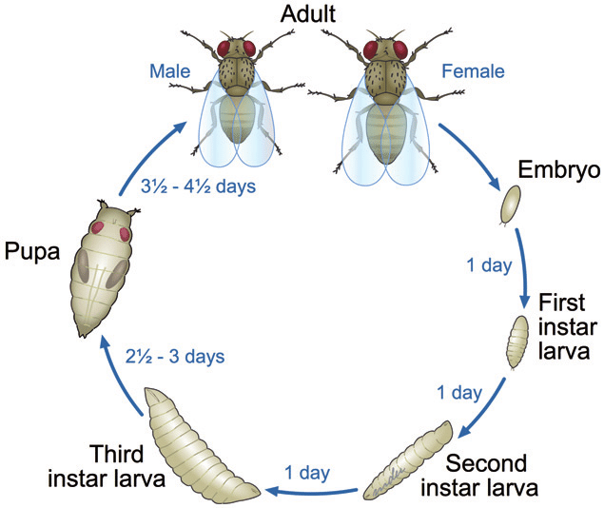
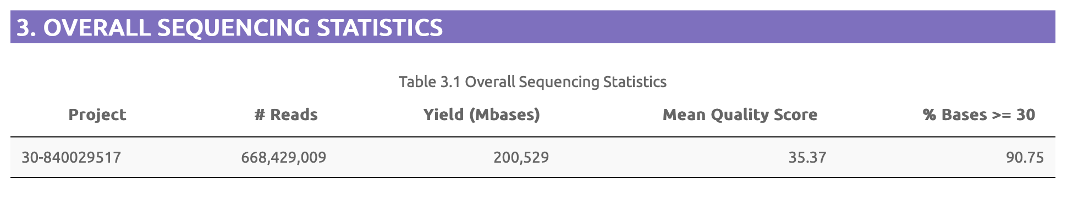
SOD1^{G85R} RNAseq Experimental Design
TKT
Genotype
Sex
TKT
TKT-OE
Sod1^{G85R}
Female
Control
TKT-Df
Silent
TKT-OE
Male
Control
TKT-Df
x3
RNAseq
TKT-OE
Female
Control
TKT-Df
G85R
TKT-OE
Male
Control
TKT-Df

Slide 8
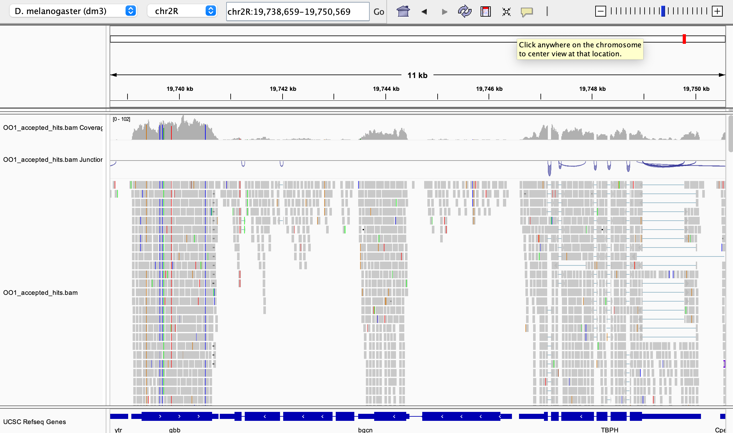
Processing transcriptome data
Each 50bp read needs to be aligned to the 220.6Mbp genome
The number of reads aligned to a gene are used to indicate the level of gene expression
These are normalized to the total number of reads in the library
These counts per million reads (CPM) are compared between conditions to determine significant differential expression
Sex dependent and independent DEGs in G85R relative to the silent control

Slide 9
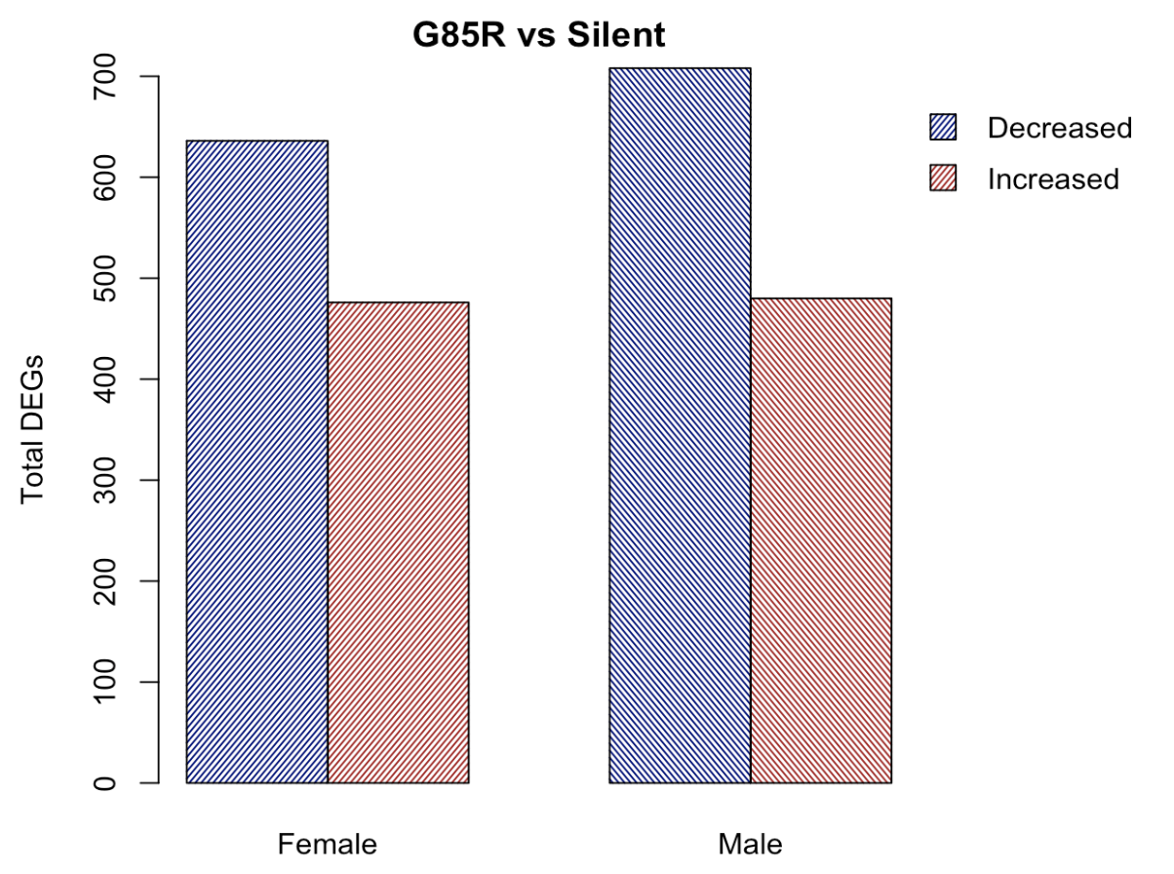
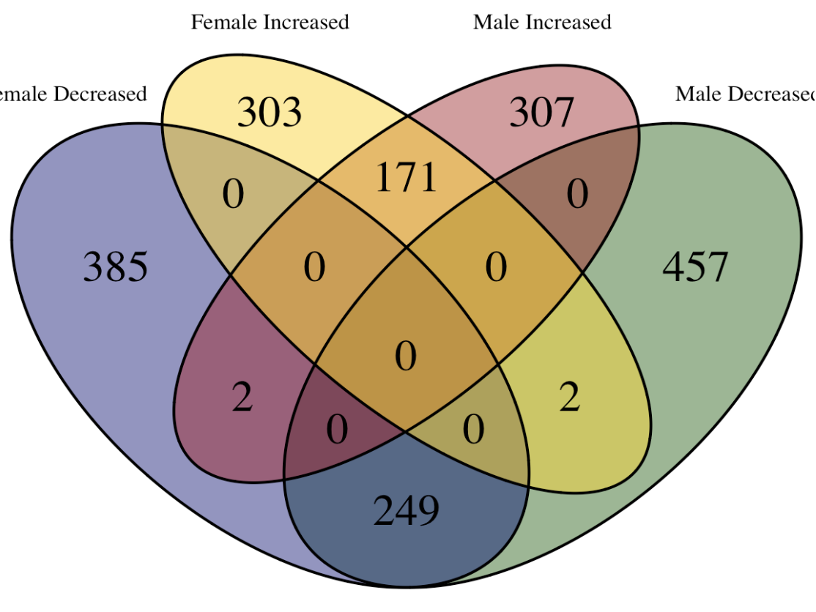
What is different between G85R and WT controls
Female
Increased
Male
Increased
Female
Decreased
Male
Decreased
Total number of genes with significantly increased or decreased expression between Silent and G85R for each sex
Sex dependent and independent DEGs in G85R relative to the silent control

Slide 10
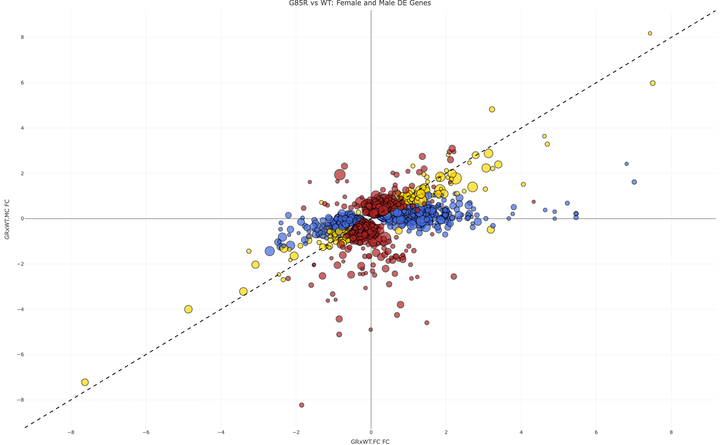
Female (blue) and Male (red) DEGs

Slide 11
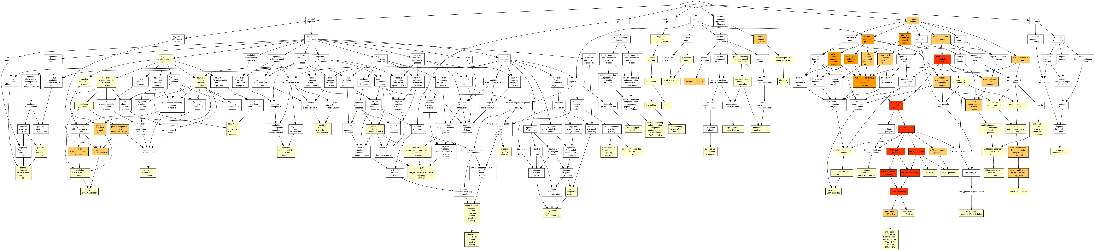
Understanding the functions of DEGs
Genes with annotated functions are characterized into different Gene Ontology categories
We test to see if our gene set has more genes from a category than expected based on all genes that were tested
There are 3 major categories of GO terms:
Cellular Component
Biological Process
Molecular Function
Above is an example of enriched ‘Biological Process” terms

Slide 12
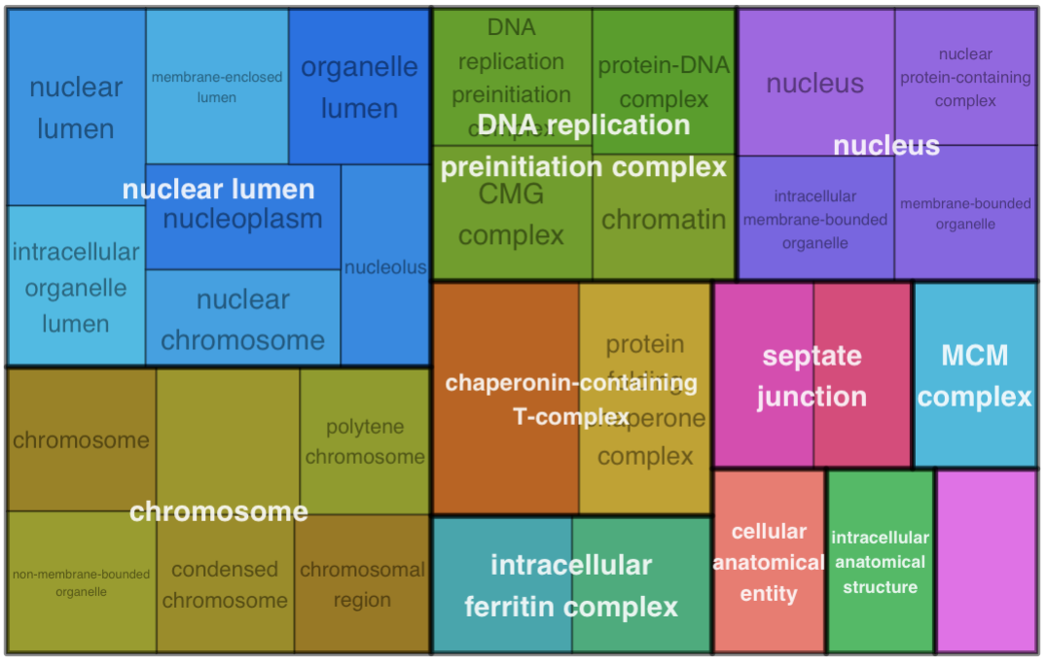
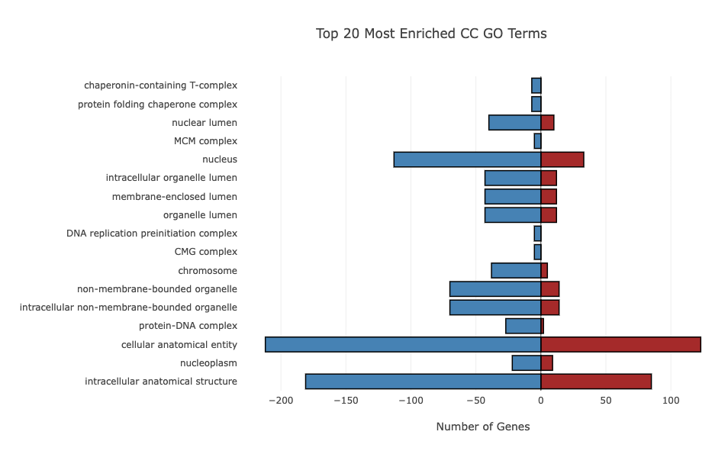
Sex Independent DEG GO term enrichment
Enriched Cellular Component GO terms
Genes that were sigDEG in male and female between G85R and WT with same direction of fold change in both sexes

Slide 13
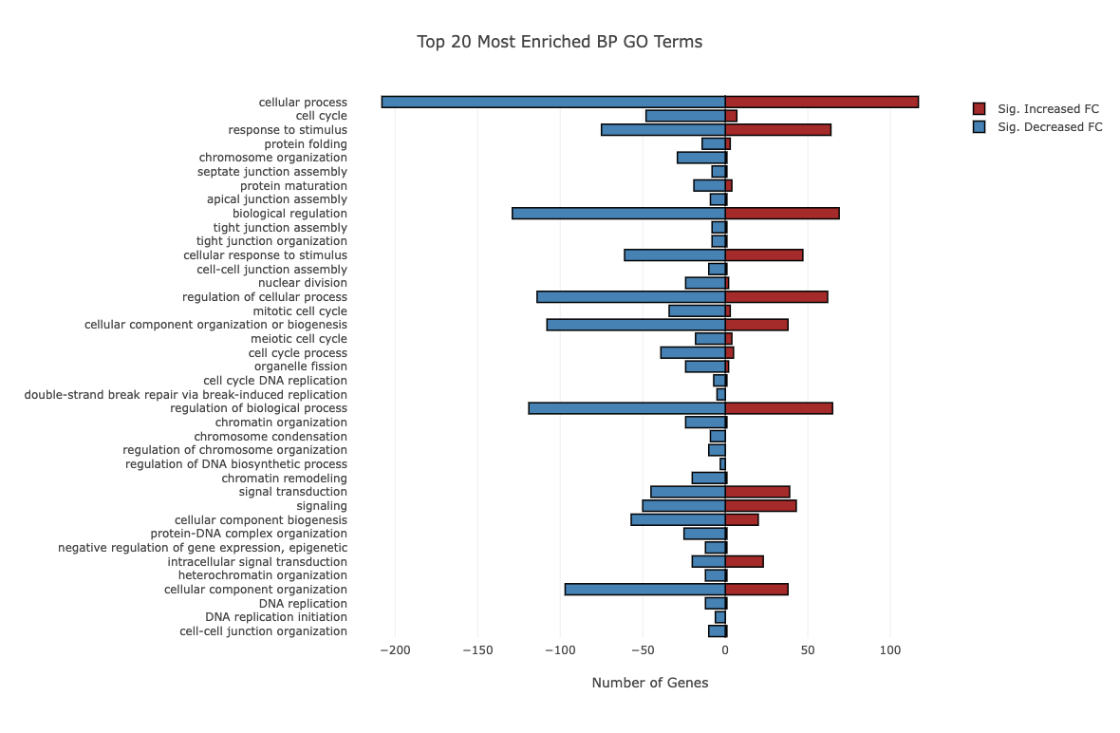
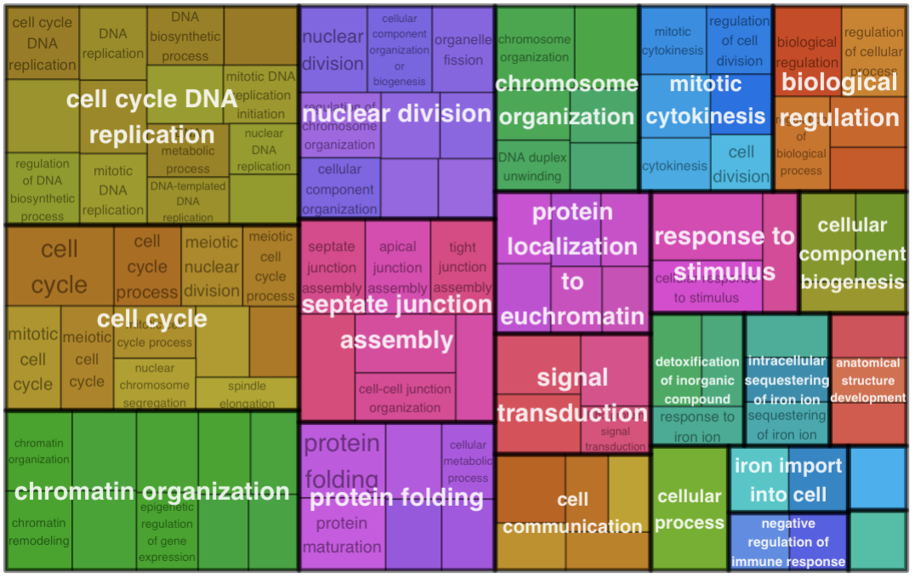
Sex Independent DEG GO term enrichment
Enriched Biological Process GO terms

Slide 14
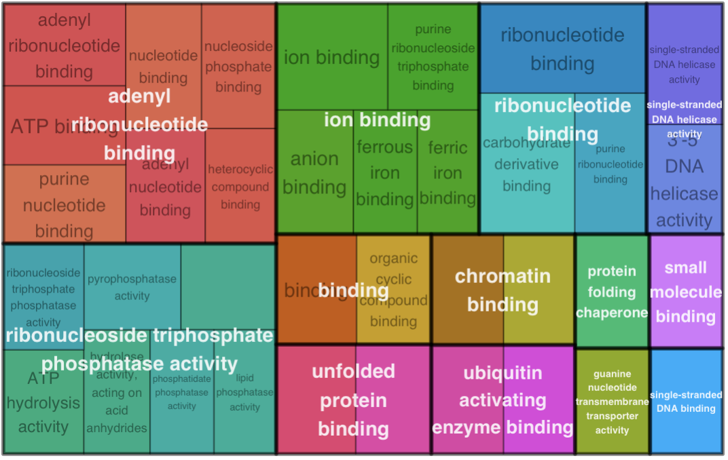
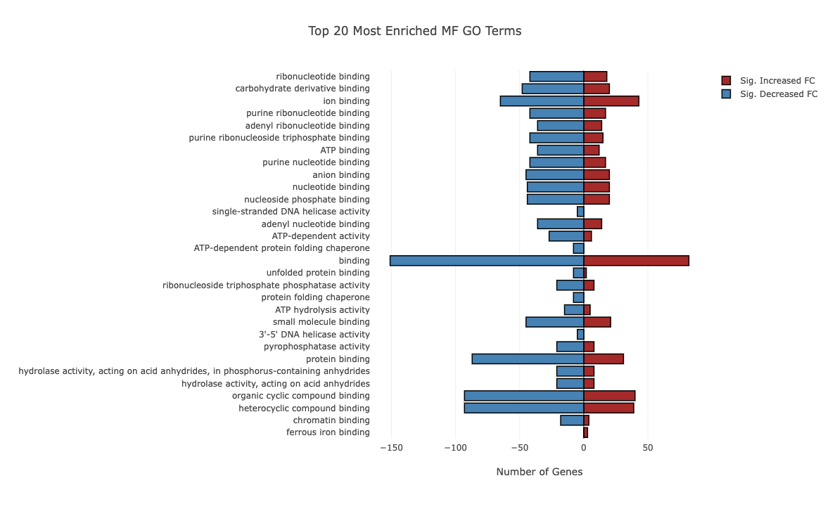
Sex Independent DEG GO term enrichment
Enriched Molecular Function GO terms

Slide 15
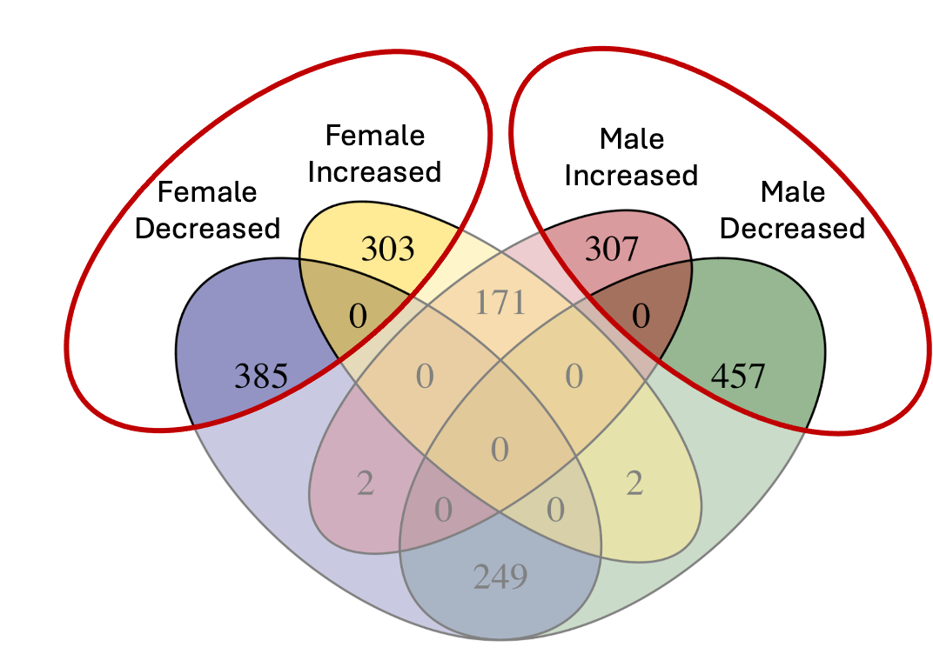
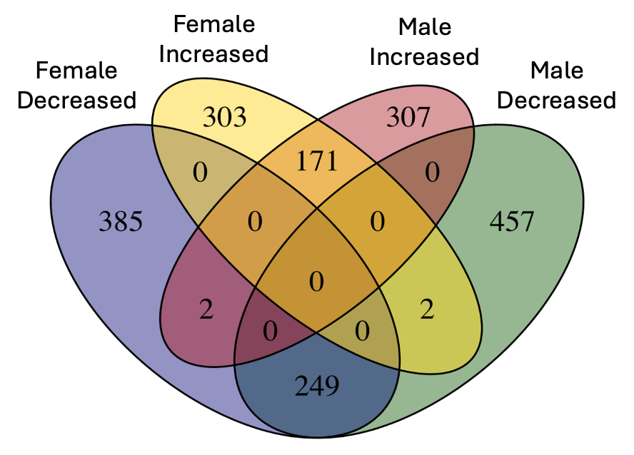
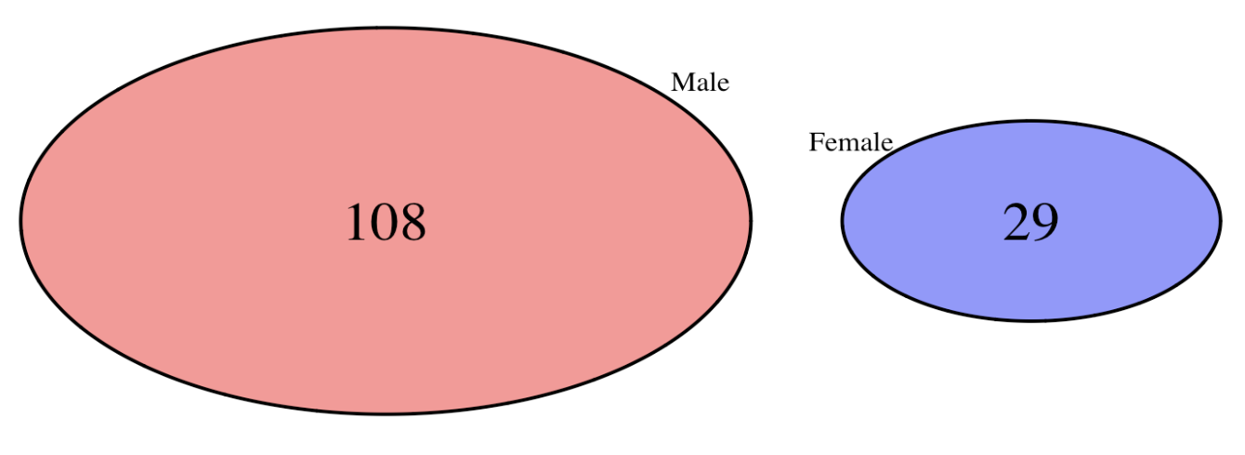
Enriched GO terms in sex specific DEGs
Nearly the same number of DEGs but no overlapping enriched GO terms
Males also have many more enriched categories than females

Slide 16
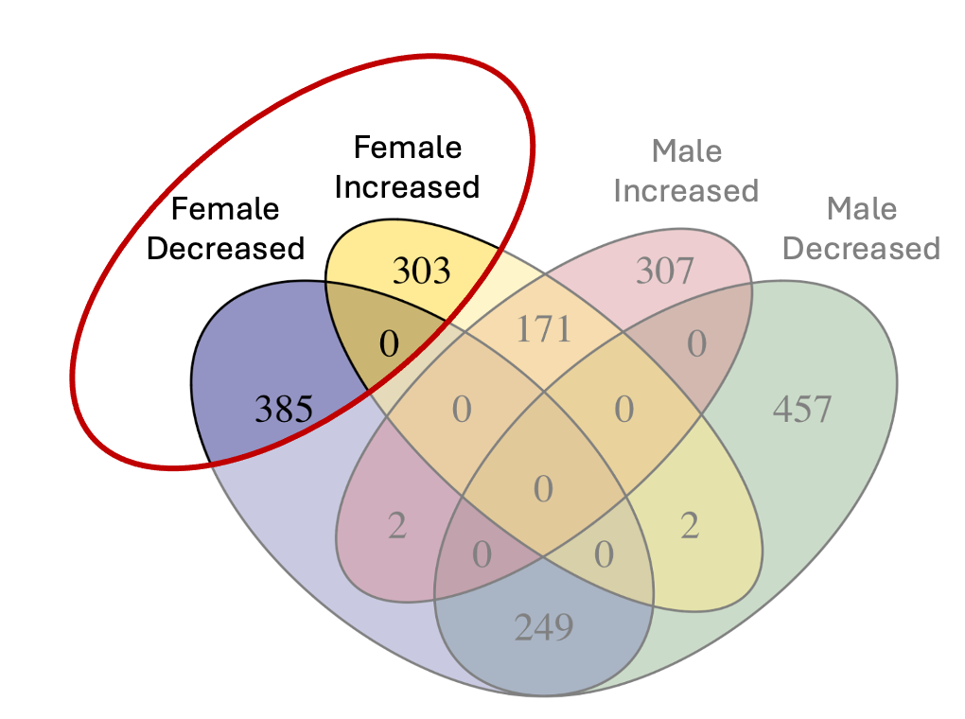
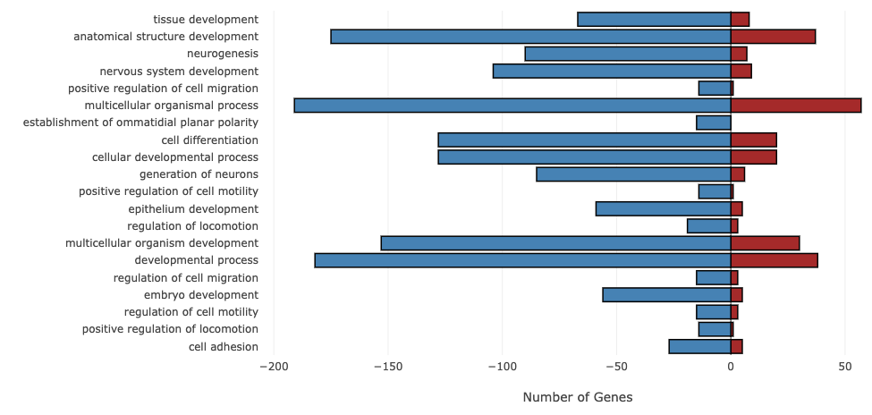
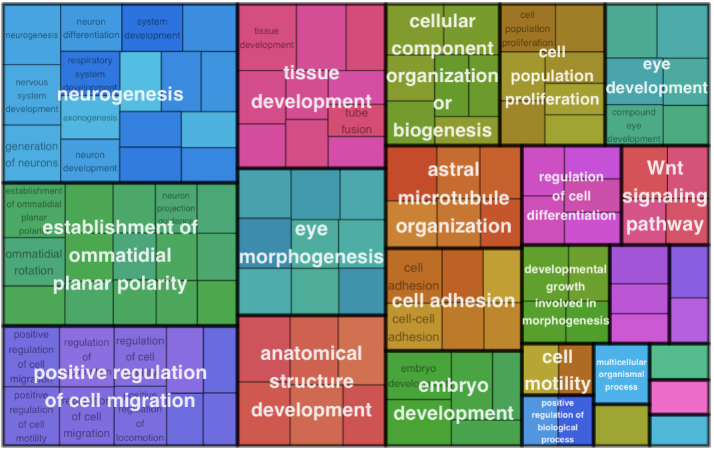
Enriched BP From the Female Only DEGs

Slide 17
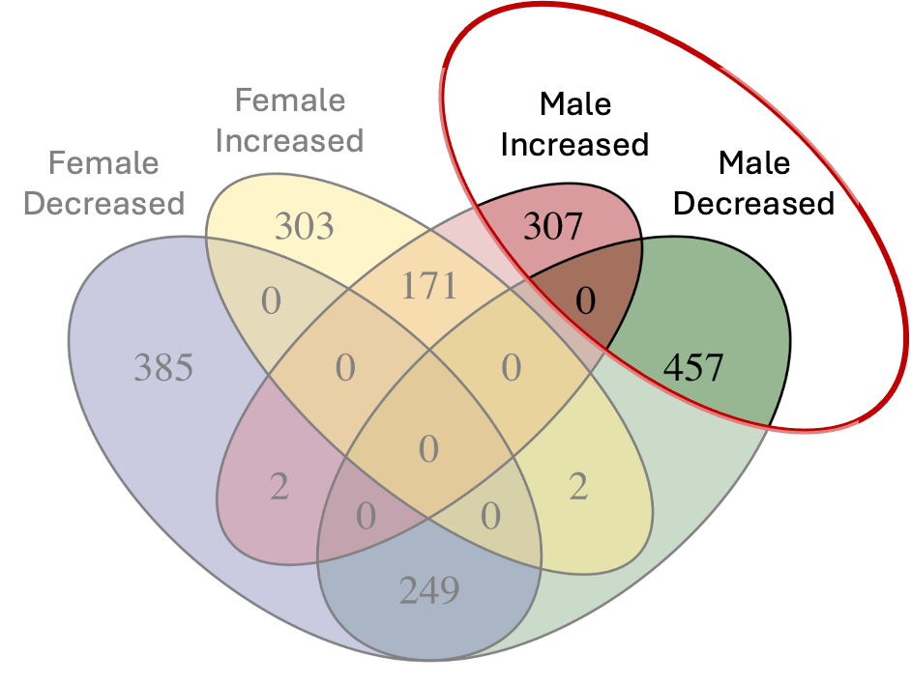
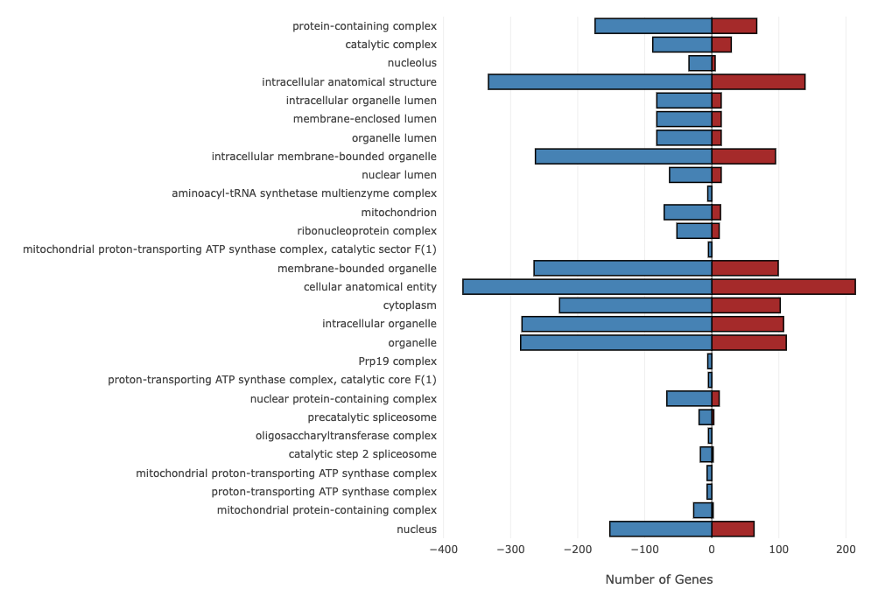
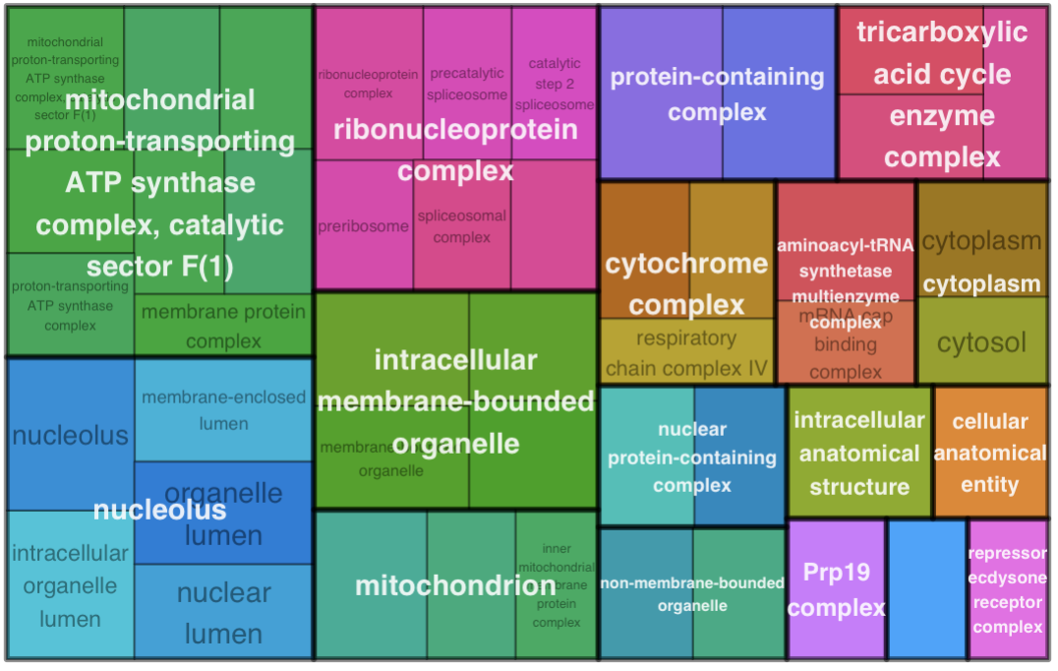
Enriched CC From the Male Only DEGs

Slide 18
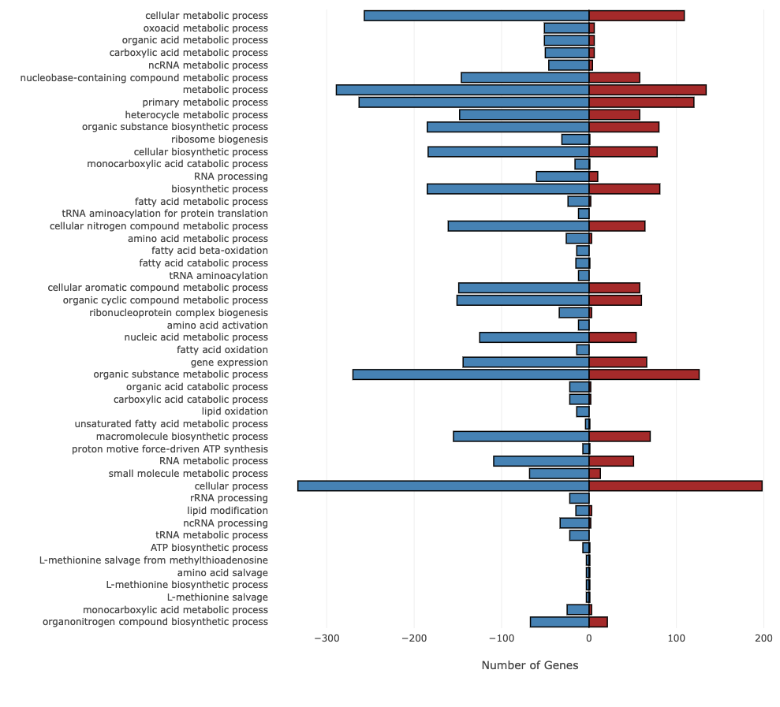
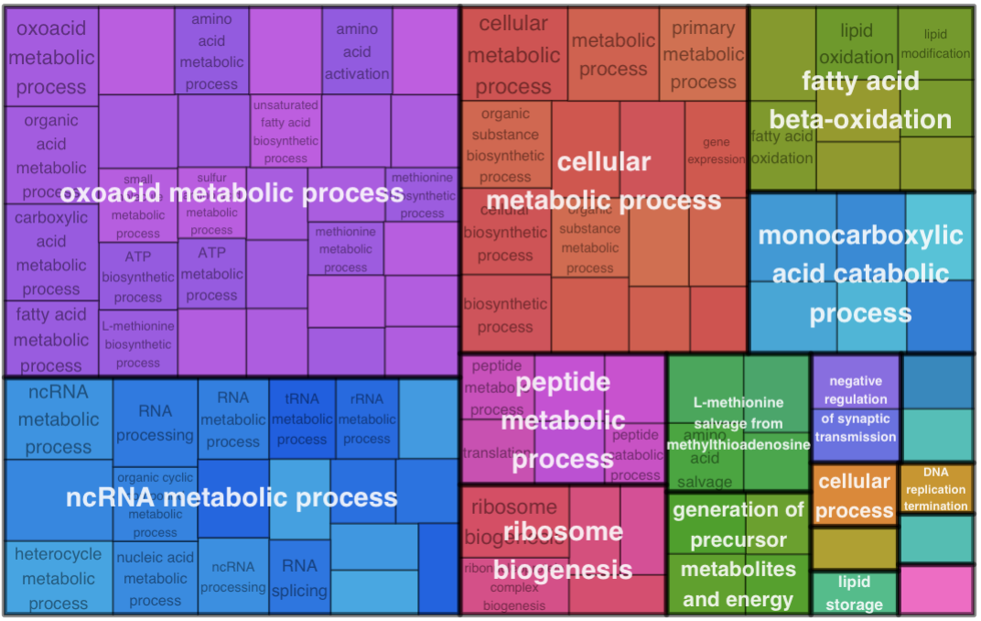
Enriched BP From the Male Only DEGs

Slide 19
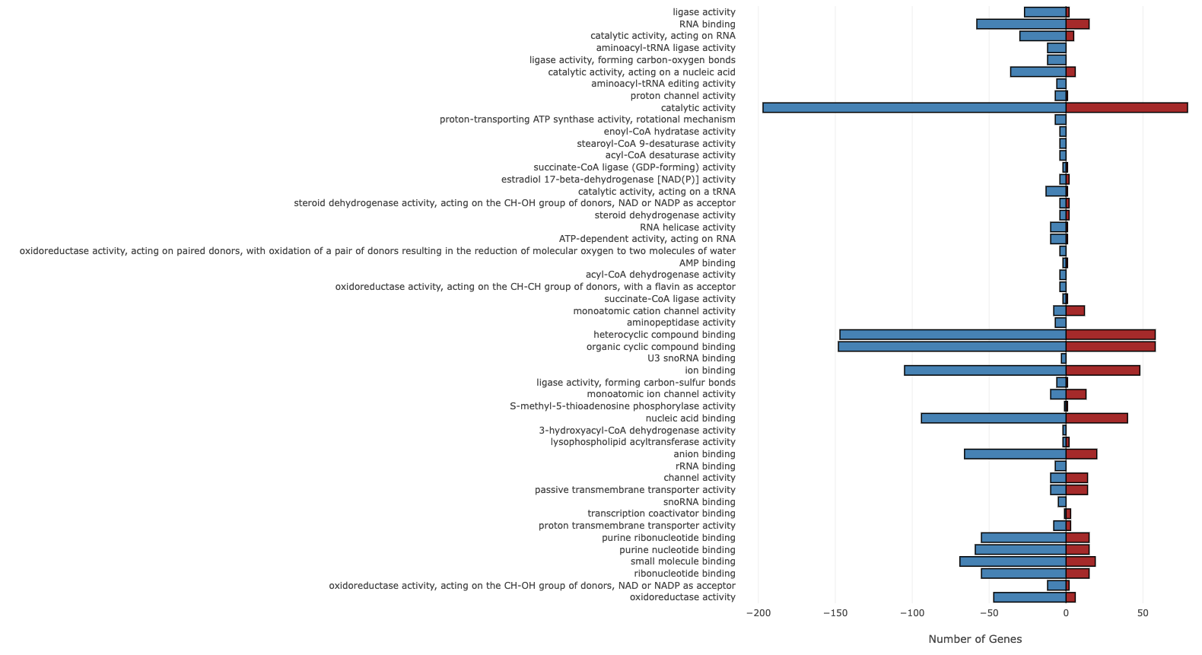
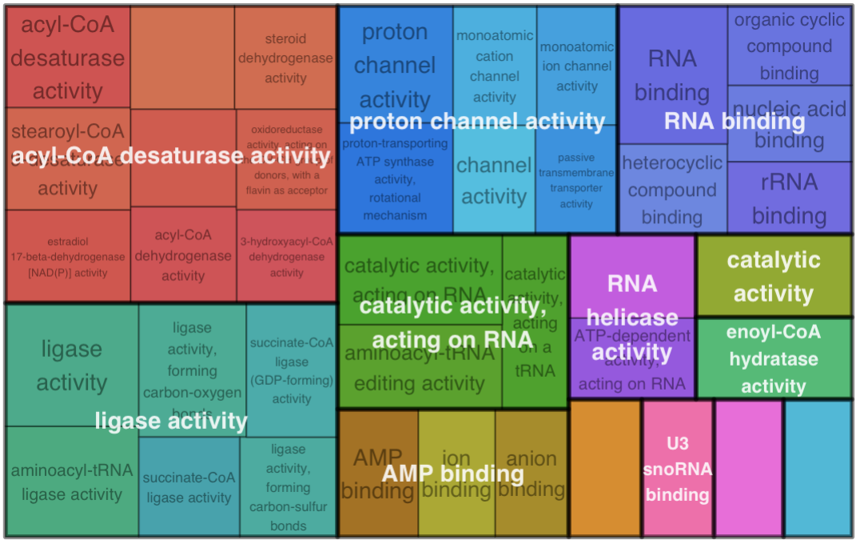
Enriched MF From the Male Only DEGs

Slide 20
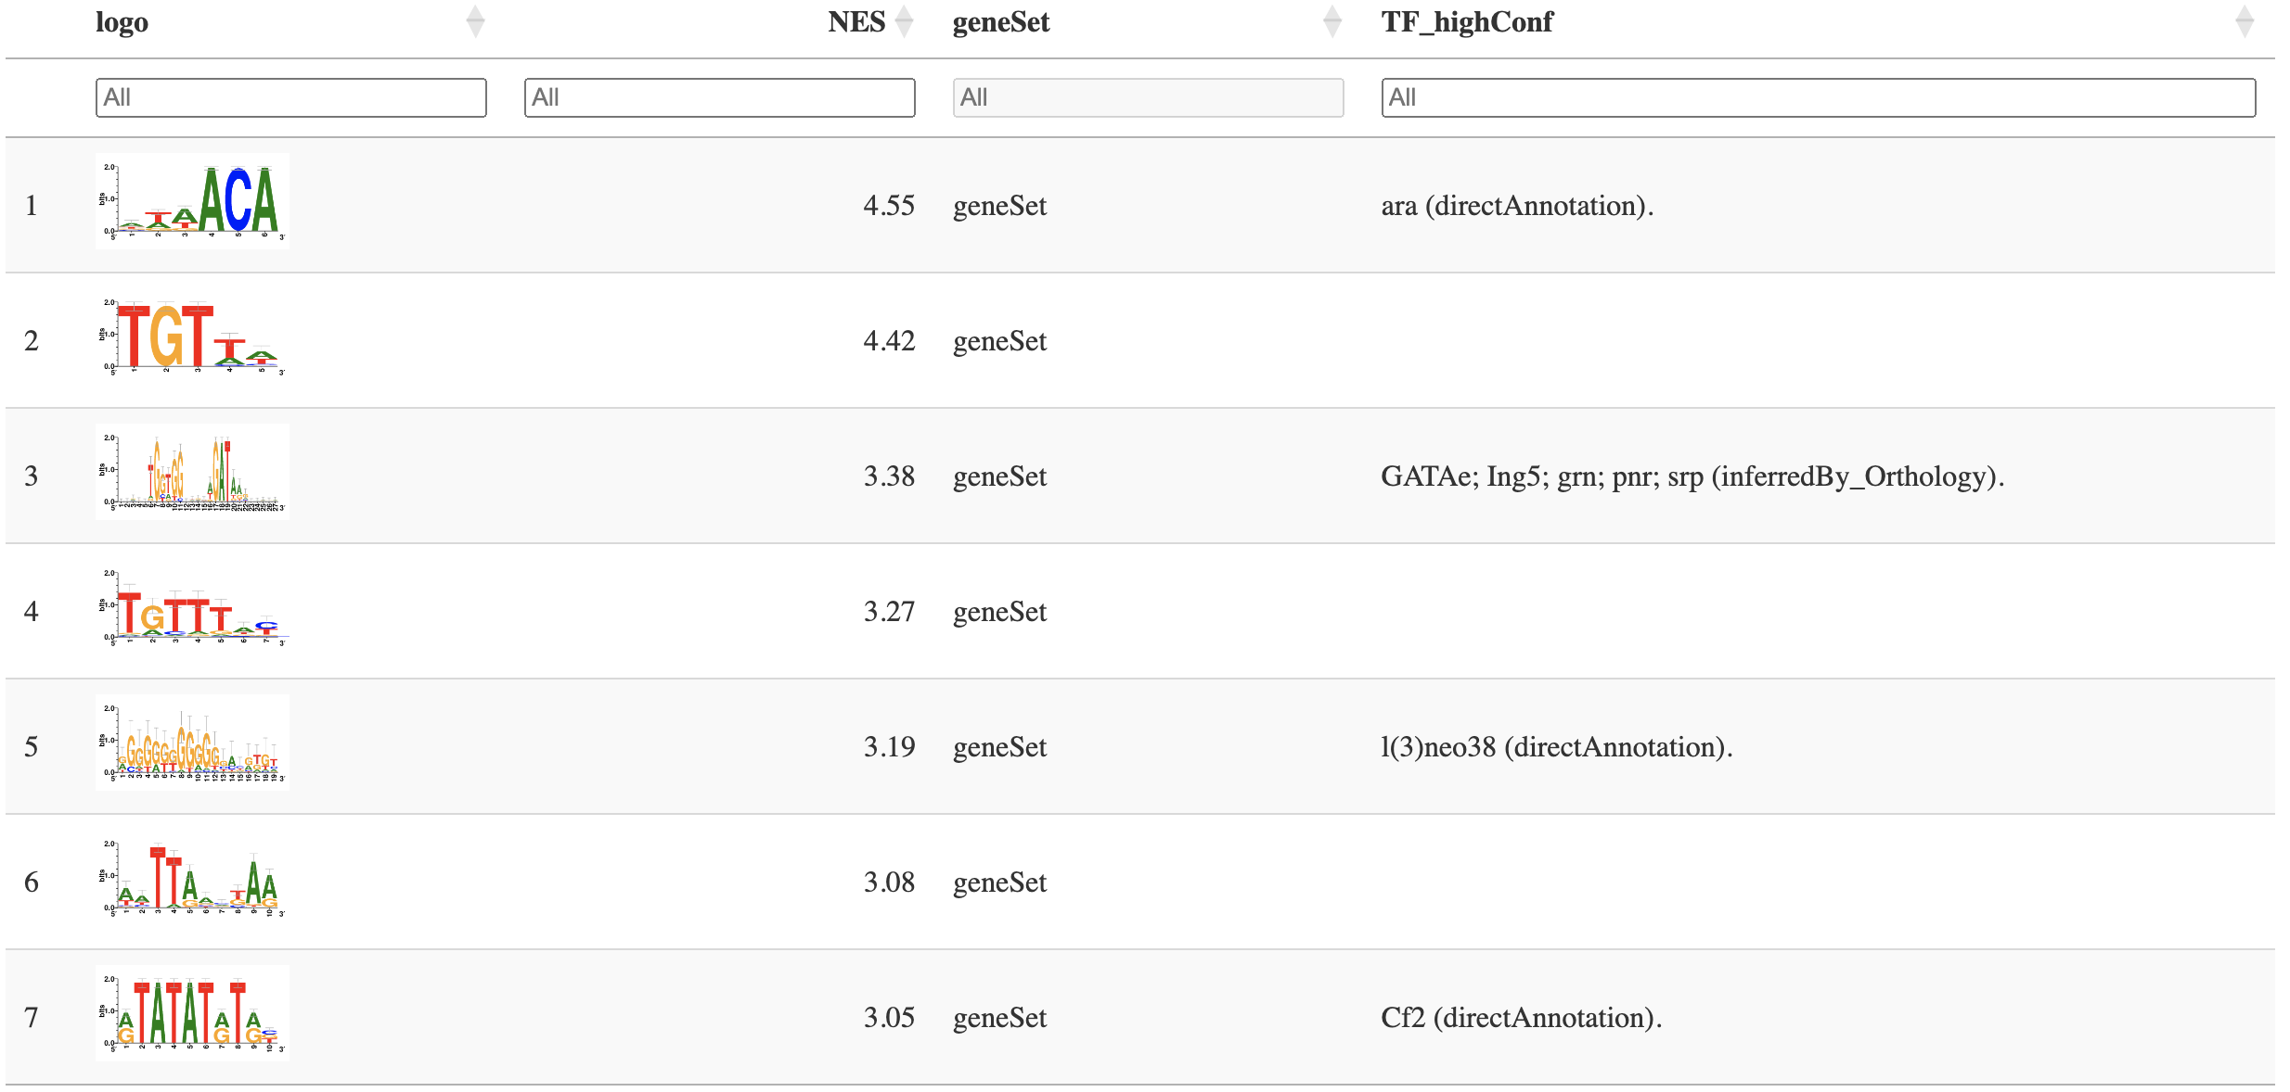
Transcription Factor Binding Motif Enrichment Analysis: Sex Independent DEGs
araucan (ara) has lots of neuronal abnormalities associated with mutant lines.
Also has larval/pupal death phenotype
62 of the 420 genes had this motif upstream

Slide 21
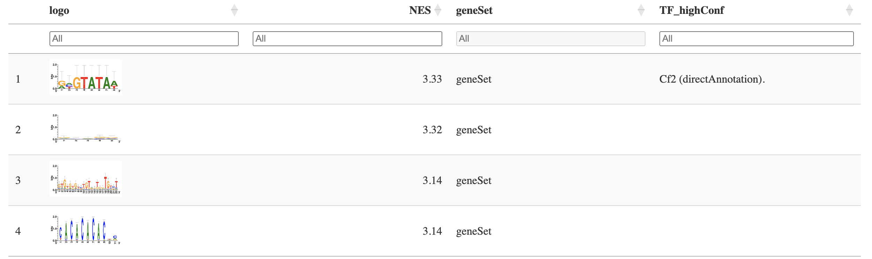
Transcription Factor Binding Motif Enrichment Analysis: Male only DEGs
Chorion factor 2 shows up again playing a bigger role in the males specific DEGs
associated with 67 of the 764 DEGs

Slide 22
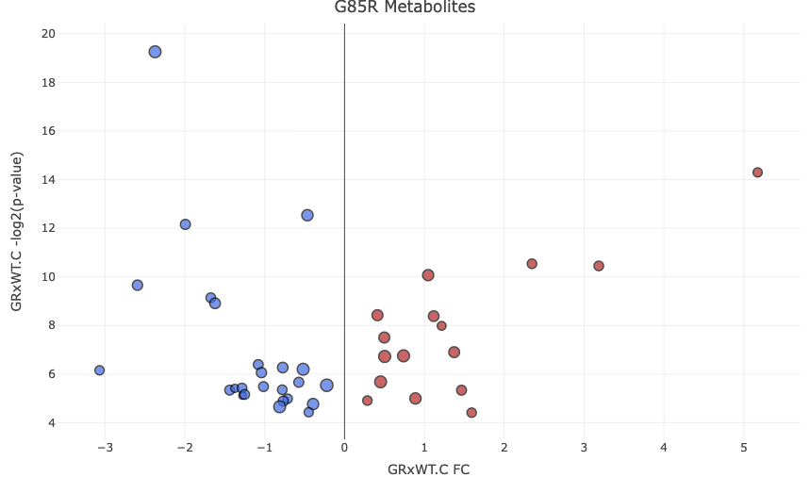
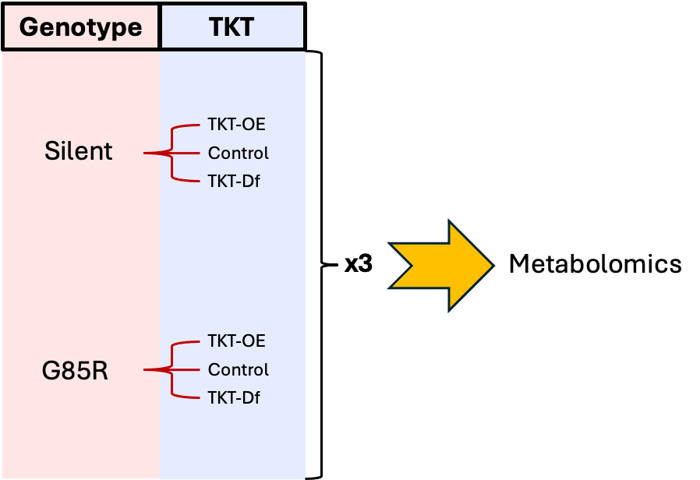
Metabolomics data
 | FC | FDR
uric acid | -2.37 | 19.26
deoxyinosine | 5.17 | 14.30
b-alanine | -0.47 | 12.54
nicotinamide riboside+ | -1.99 | 12.16
guanine | 3.18 | 10.45
hydroxyphenyllactic acid / HVA | 2.35 | 10.54
homoserine / threonine / allothreonine | 1.05 | 10.07
xanthine | -2.59 | 9.66
NMN | -1.68 | 9.14
deoxycarnitine+ | -1.62 | 8.91
adenine | 1.12 | 8.38
glycine | 0.41 | 8.42
F1P | 1.22 | 7.98
acrylic acid | 0.50 | 7.50
glutamine | 0.50 | 6.72
guanosine | 1.37 | 6.90
phosphorylcholine+ | 0.74 | 6.75
pyridoxal | -1.08 | 6.39
2-HG | -0.52 | 6.20
3-phospho-serine | -3.07 | 6.15
N-acetylaspartic acid | -0.77 | 6.27
D-sedoheptulose-7-phosphate | -1.04 | 6.06
2-oxoadipic acid | -1.44 | 5.34
3-hydroxykynurenine | -1.02 | 5.48
AICA ribonucleotide | -1.37 | 5.41
citramalic acid | -0.57 | 5.66
D-ribose-1/5-phosphate / D-ribulose 5-phosphate | -0.78 | 5.35
isonictinic acid | -1.28 | 5.42
proline | -0.22 | 5.54
pyrroline hydroxycarboxylic acid | 0.45 | 5.68
urea | 1.47 | 5.34
2,3-bisphospho-D-glycerate | -1.28 | 5.12
NAD+ | -1.25 | 5.16
imidazole-4-acetate | -0.71 | 4.99
inosine | 0.89 | 5.00
agmatine | 0.29 | 4.91
cytidine | -0.77 | 4.89
mesaconic acid | -0.39 | 4.77
histidine | -0.81 | 4.65
N-acetyl-L-glutamic acid | -0.45 | 4.43
orotic acid | 1.59 | 4.41
Genotype
TKT
TKT-OE
Silent
Control
TKT-Df
x3
Metabolomics
TKT-OE
G85R
Control
TKT-Df

Slide 23
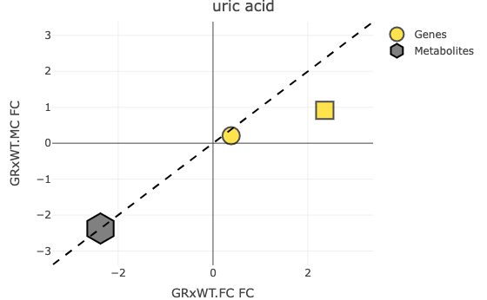
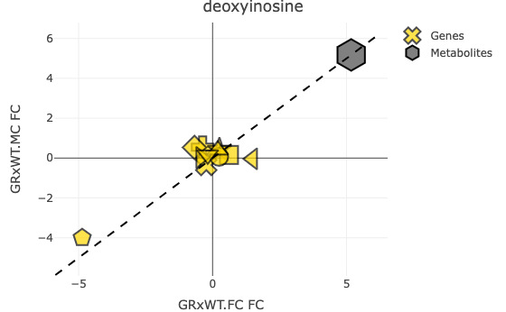
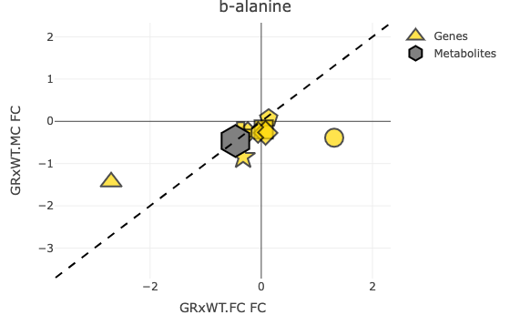
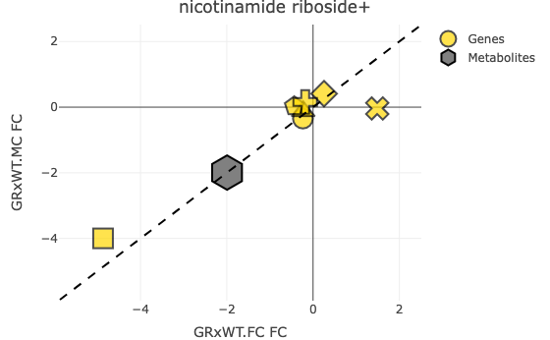
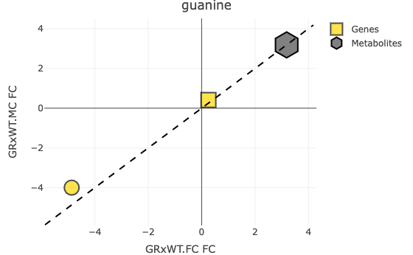
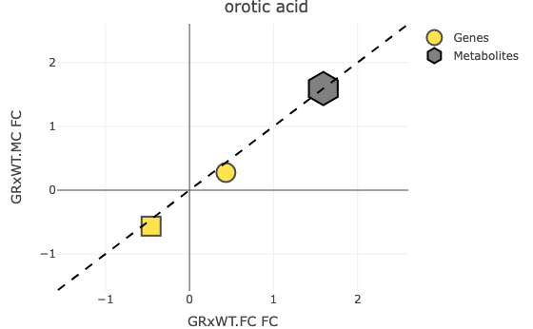
Top metabolites with enzymes

Slide 24
Stuff for another time
Integrating metabolomic with transcriptomic
KEGG pathways
TKT rescue effects

